Slide 1

Career Outlook
Find your alumni
Section II - Ocean’s 4 (Jiehan Liu, Peihan Gao, Ning Tang, Sushan Zhao)
MACS 30122 - Winter 2022
Notes:
Free to change

Slide 2
Introduction
Inspired by social learning analysis in the social science, people make decisions in the use of information they learned.
Here in this project, we aim to provide a web-application that assists job hunters to evaluate their career goals through alumni career paths.
With similar educational background and experience, alumni association can be used to assess the feasibility of their career goal.
Notes:
How many of you are looking for jobs? Summer internship? Raise your hand if you are on linkedin? This is the project for you!

Slide 3
Data Collection
Data | Info | Resource | Strategy
Randomly Selected Colleges | U.S. News Best Colleges in 2022 | Andrew G. Reiter, “U.S. News & World Report Historical Liberal Arts College and University Rankings,” available at: http://andyreiter.com/datasets/ | Collection
Individual Profiles from LinkedIn | Individual Profile URLs | LinkedIn School Alumni List | Web Scraping
 | Detailed Individual Information (Location, Career path and Education etc.) | LinkedIn Individual Profile Page | Web Scraping
Occupational Wage Statistics | Average Annual Salary per Industry | Bureau of Labor Statistics https://www.bls.gov/oes/current/oes_research_estimates.html | Collection
Notes:
So we started our journey with Data collection. We did 4 rounds of data scraping in total… yes we did lots of work.

Slide 4
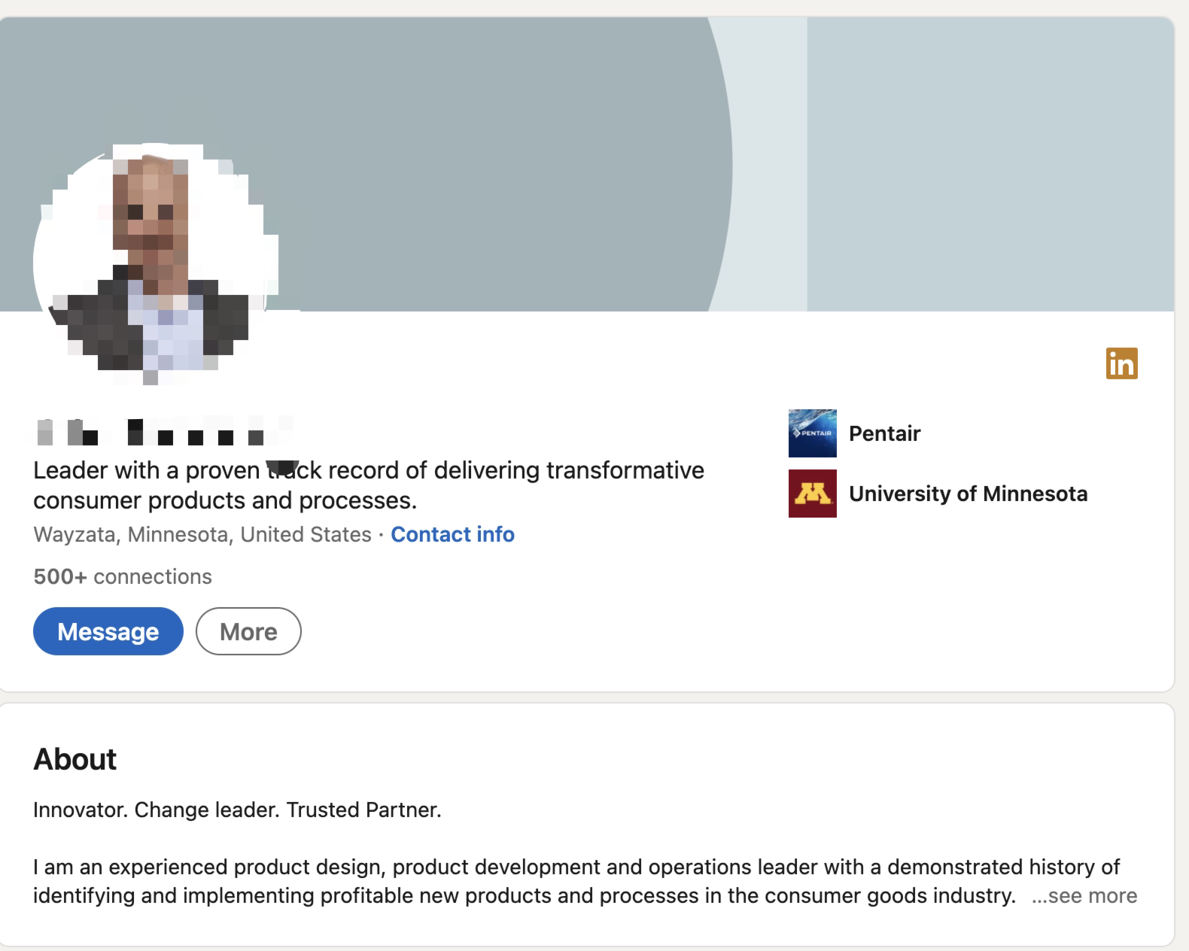
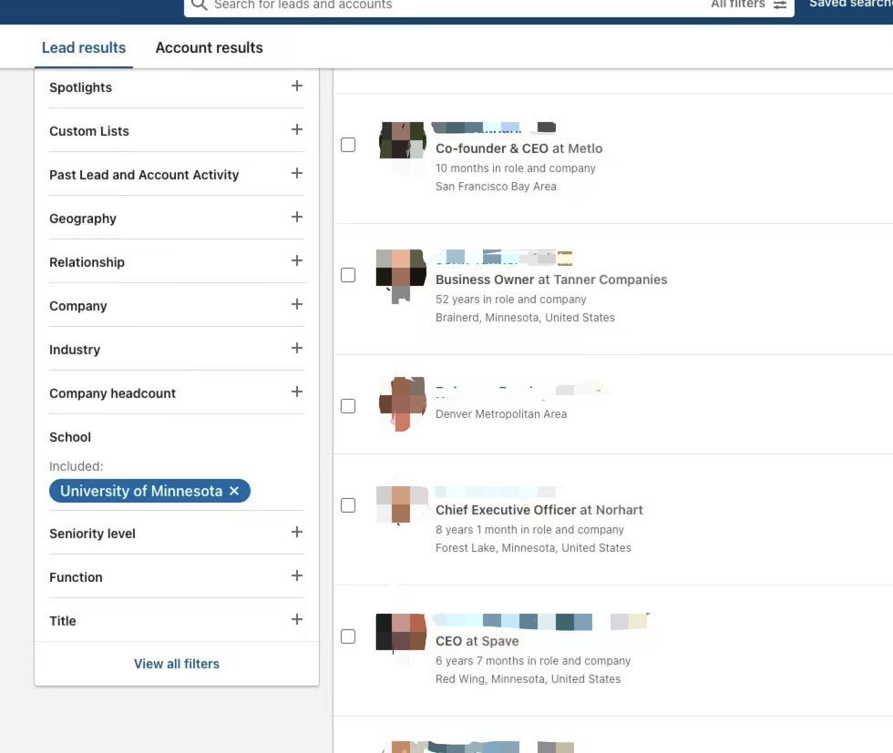
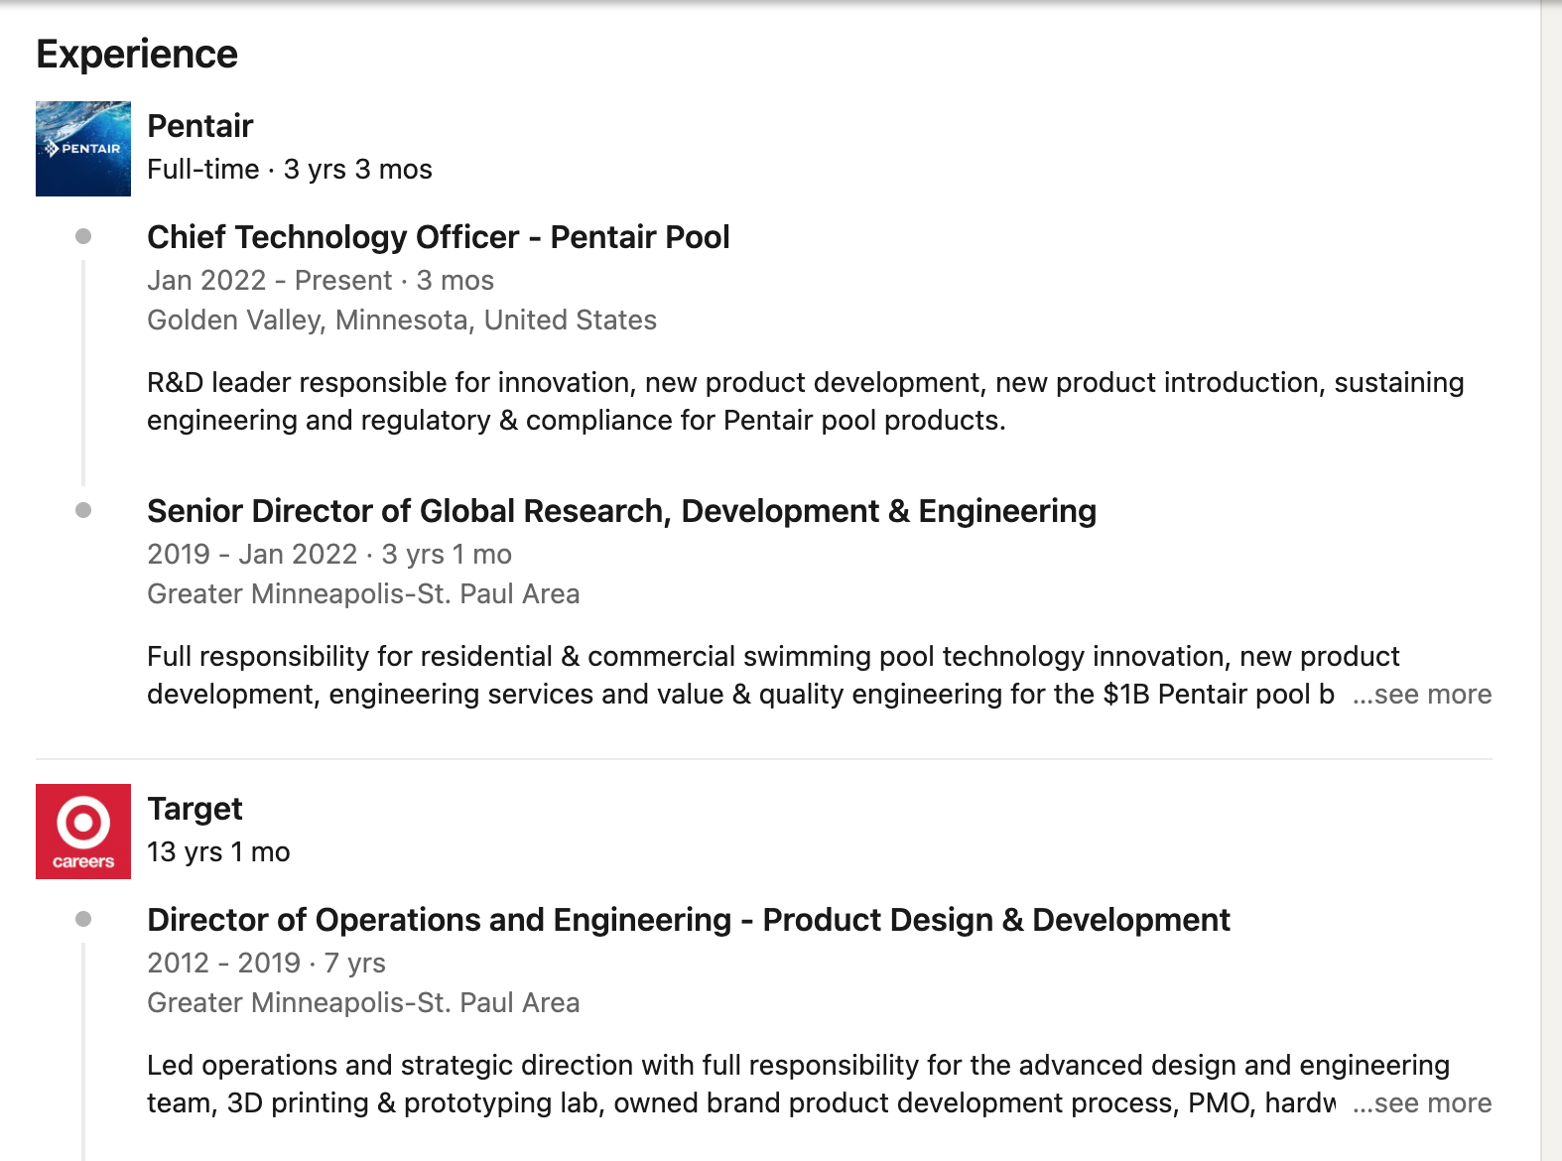
LinkedIn School Alumni List
LinkedIn Individual Profile

Slide 5
Data Collection
Data | Info | Resource | Strategy
Industry NAICS Code | Industry Classification | Bureau of Labor Statistics https://www.bls.gov/oes/current/oessrci.html | Collection
Company Information | Industry Category (NAICS code) for Every Company | https://www.ebscoind.com/ | Web Scraping
Geographical Data | Alumni Employment Location | https://nominatim.org/ https://www.nrcs.usda.gov/wps/portal/nrcs/detail/national/home/?cid=nrcs143_013697 | Web Scraping
Notes:
Challenges: we have to log in back every 4mins to scrap company info.
Map: focus on counties only not including individual city. Irvine exp

Slide 6
Data Cleaning & Processing
Drop row duplicates
Match companies with industries
Data Cleaning
Match industries with NAICS code
Retrieve missing rows
Match NAICS code with Salaries
Rearrange Data
Match locations with coordinates
Data Processing
Fix rows with inappropriate data.
Match coordinates with fips codes
Notes:
Sth we learned from our data cleaning exp and really want to share out is be careful while dropping row duplicates which may cause additional missing values. Exp: linkedin drop two different ppl
记得补上我们做的好的地方去分享, we clean everytime before matching

Slide 7
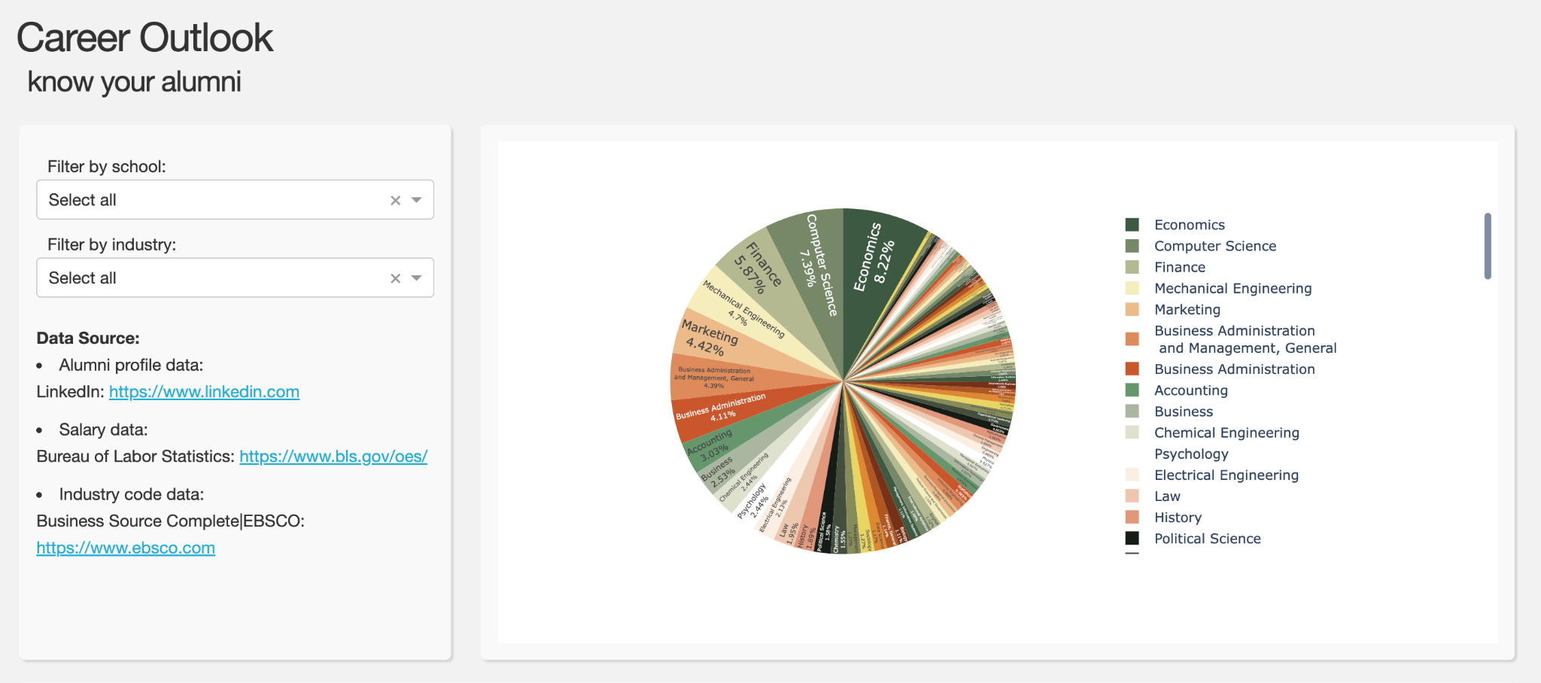
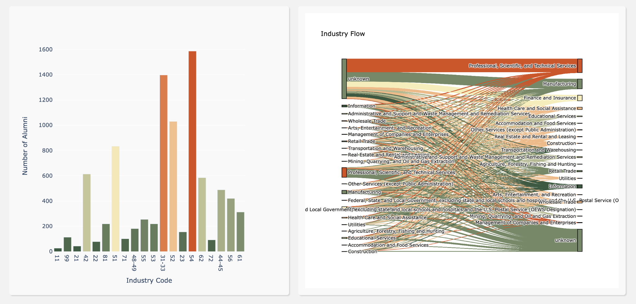
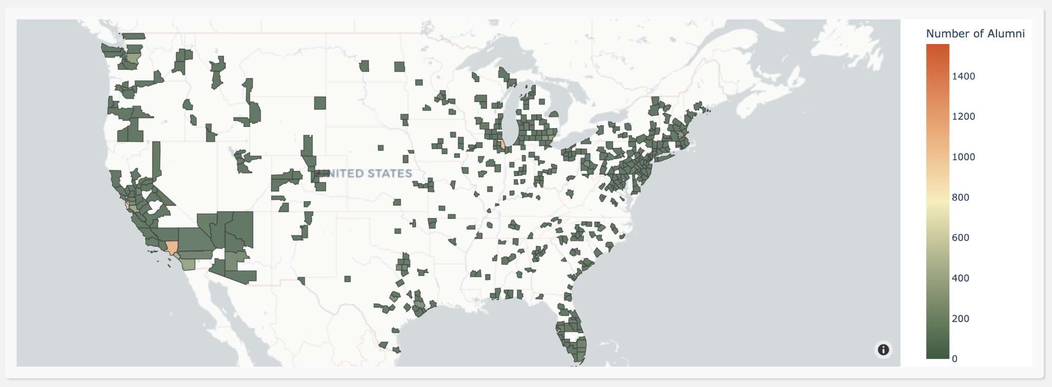
Web Application Interaction
Notes:
Plotly , dash
Major, current location, industry flow (previous, current), industry distribution
“Select all, select all” :
Major: background limit
Location: la, miami, ny, limit (chicago)
Industry: due to educational background finance & technology, finance is still more profitable than technology :)
Industry flow: complex, see a specific university
Similar university “harvard, select all”:
Location: locate near university (boston, new york), still love la
Industry: tech, finance, manufacturing
Flow: industry database (business journals, top 30% companies, unknown), previous finance & tech — startup or unicorn; Some motivations for us : as long as you have tech background, if you will want, you can switch to the tech industry whenever you want to.

Slide 8
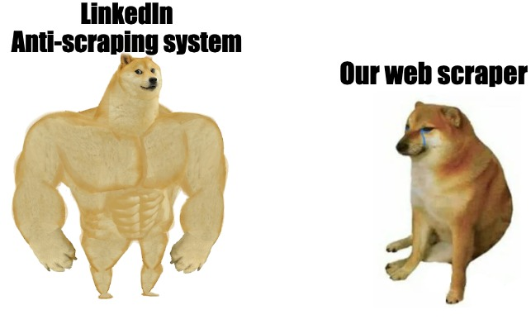
Challenges
LinkedIn's anti-scraping algorithm
LinkedIn’s connection algorithm
Incomplete company information
Lack of representativeness
Notes:
As we’ve mentioned earlier…..
Block
First recommend similar bg and nearby location, sales navigator eliminate effect
Business journal
8 schools, randomly, not representative

Slide 9

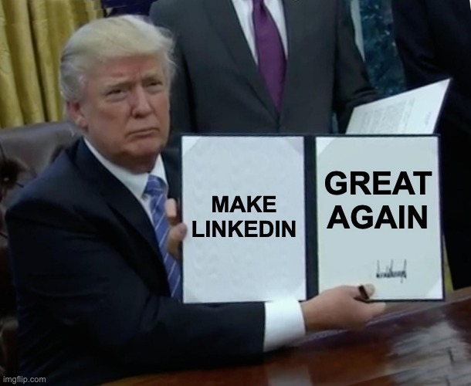
Project Conclusion
Overall, we wants to bring blue pictures to our application users, with this web application. Unlike LinkedIn platform itself, our target users will be potential graduates or alumnus who are seeking for career changes.
For the future development
Expand sample size
Financial Support (Alumni associations across universities)
Compete with LinkedIn or Win-Win :)
Notes:
Great job
If we have chance, continue, add more university
Sales navigator, $100 expensive
Create platform with different functions to compete; or work with linkedin (anti-scraping so annoying) to explore more functions

Slide 10
Thank you for your listening !
Ocean’s 4 -

